Slide 1

CS4243 Final Project
Group 7
A0190686R Tan Ye Kai
A0187372W Chen Hui
A0204685B Liu Jingming

Slide 2
Table of contents
Project description
Data collection
Data exploration
Pre-processing
Data analysis with deep learning
Numerical results

Slide 3
Project Aim
We aim to classify whether an image is Computer Generated Imagery (CGI) or Photographic Image (PI)
CGI: still or animated content made with computer software and is typically used in movies, television and games
PI: a picture made using a camera

Slide 4
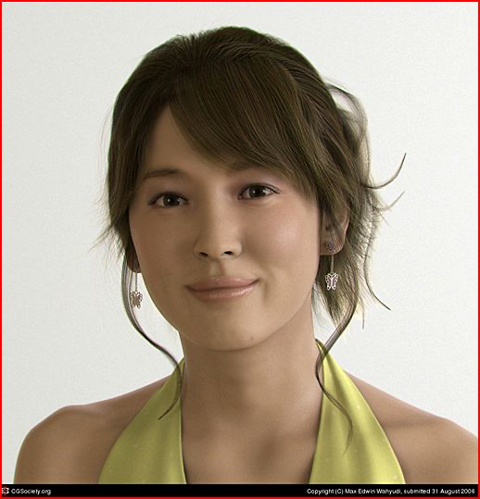
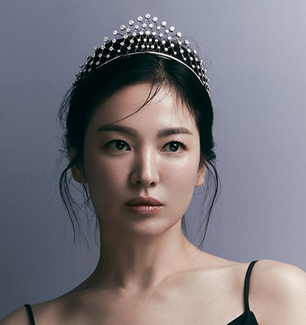
Project Motivation
Advances in CGI software and AI are creating increasingly realistic images
In an experiment on 200 participants, they could only differentiate AI generated images from real images 48.2% of the time.
We have decided to focus our project on images of human faces because we believe that this is where the greatest potential for abuse lies
Can’t tell which is CGI?

Slide 5
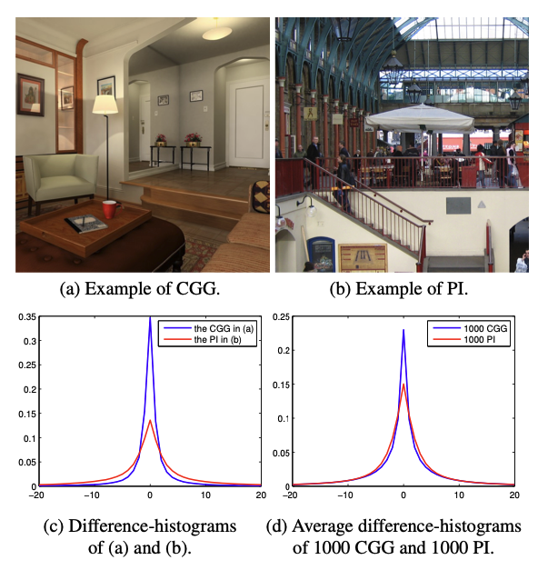
Related works
Wu et al., used histograms of the difference images (i.e. the images composed of differences of adjacent pixels) and afterwards takes the most informative histograms as features.

Slide 6
Related works
Rahmouni et al. uses histograms to a CNN framework and finds the best features for efficient boundary
Nguyen et al. proposes the use of a modular VGG-19 as the main model
For our project, we would like to explore the VGG model and find out the internal workings of the multiple layers. We would also like to explore our dataset and decide on our own features to include as inputs to the model (see section 3 and 4 for said features).

Slide 7
Table of contents
Project description
Data collection
Data exploration
Pre-processing
Data analysis with deep learning
Numerical results

Slide 8
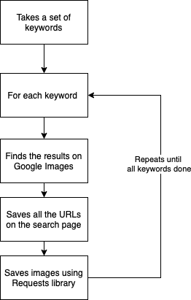
Data collection
We created our own scraper to scrape Google Images
Made use of Selenium and Requests libraries
Framework of our scraper is on the right

Slide 9
Data collection challenges
Using just "CGI faces" and "photos of faces" as search queries would have been too broad and resulted in a lot of noise in the dataset.
We had to find a way to segment the search queries
Segment the "CGI" dataset using the different use cases of CGI images - games, movies and television shows.
Segment the photographic images based on ethnicity so as to gather a diverse dataset.
Some of the search results resulted in duplicated images - use difPy library to remove them
Total of ~7000 images collected

Slide 10
Table of contents
Project description
Data collection
Data exploration
Pre-processing
Data analysis with deep learning
Numerical results

Slide 11
Data exploration
We explored our data in a few different ways:
Edge detection
Image resolution
Cropping vs resizing vs black borders

Slide 12

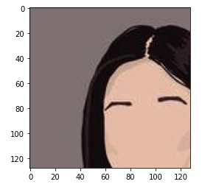
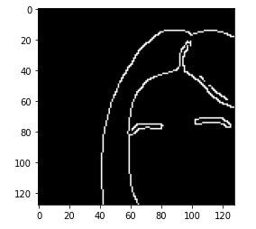
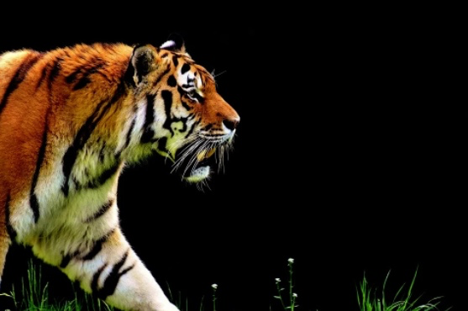
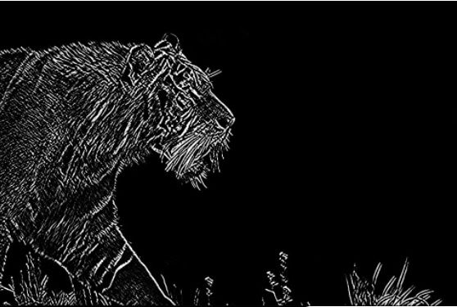
Edge detection
CGI images tend to have more distinct features
Photographic image tends to have way more edges

Slide 13
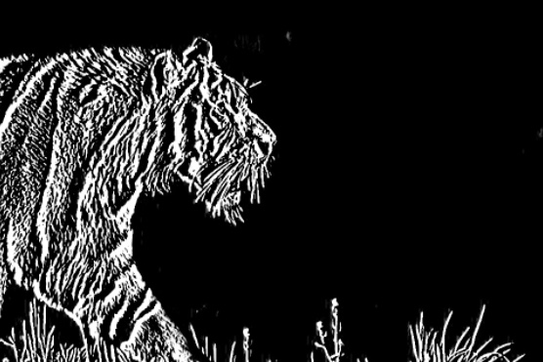
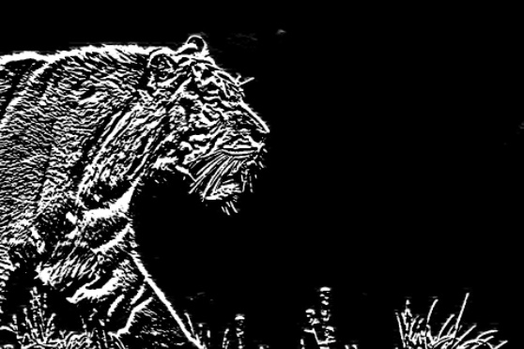
Edge detection - results
Original
sobelx
sobely
sobelxy

Slide 14
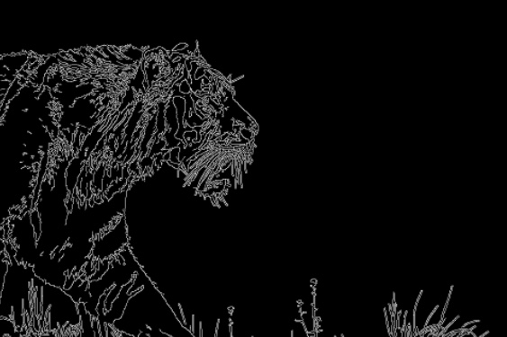
Edge detection - canny edge detection
Canny edge detection is widely used and robust.

Slide 15
Image resolution
The image resolution that we have chosen is 128 * 128
This design choice was largely due to the fact that not many image that we cropped were available with higher resolution, and that we should be consistent in our input size for our models.

Slide 16
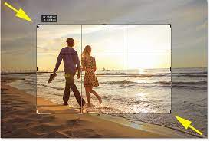
Cropping vs resizing vs adding borders
The strategy we picked was to center crop the image as shown on the left.
The benefits of doing this is that we are able to reduce the dimension of the image without losing the resolution of the images, and without altering the proportion of the images.

Slide 17
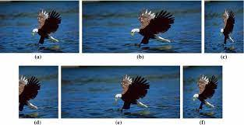
Cropping vs resizing vs adding borders
You can see that the proportion of the eagle on the left is altered, and the original image is distorted.
One downside of resizing a higher resolution to a lower resolution image is that a lot of features and pixels will be lost

Slide 18
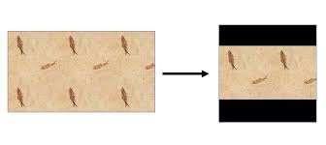
Cropping vs resizing vs adding borders
We also considered adding borders to standardise the image size.
However, this is usually not ideal because there is a lot of wasted space used for the black borders.

Slide 19
Table of contents
Project description
Data collection
Data exploration
Pre-processing
Data analysis with deep learning
Numerical results

Slide 20
Preprocessing
Center crop all the photos we had into 128 * 128 dimensions, in RGB.
Apply gray scale
Blur the grayscale image
Use (3) for sobelx, sobely, sobelxy edge detection
Use (3) for canny edge detection
Combine R,G,B,sobelx, sobely, sobelxy, canny edge detection data as inputs
Split into respective training and test set to be passed into the models.
Complete details can be found in our report.

Slide 21
Table of contents
Project description
Data collection
Data exploration
Pre-processing
Data analysis with deep learning
Numerical results

Slide 22
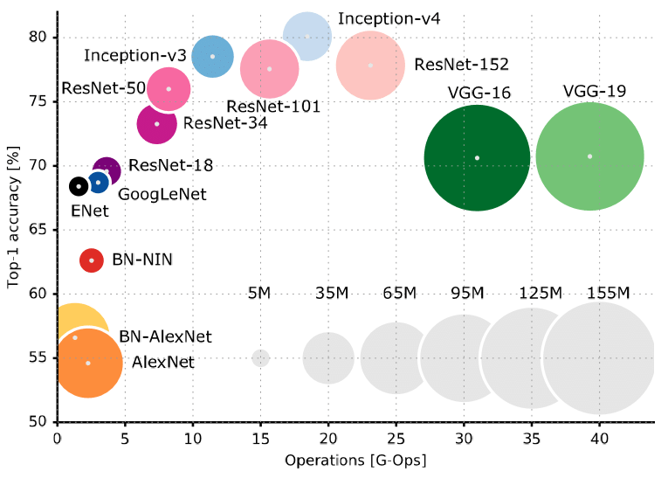
Data analysis with deep learning
Logistic Regression
AlexNet
LeNet
VGGNet
Logistic Regression | AlexNet | LeNet | VGGNet

Slide 23
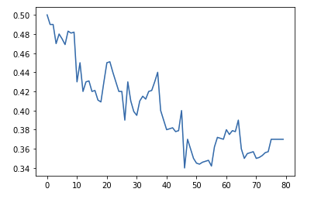
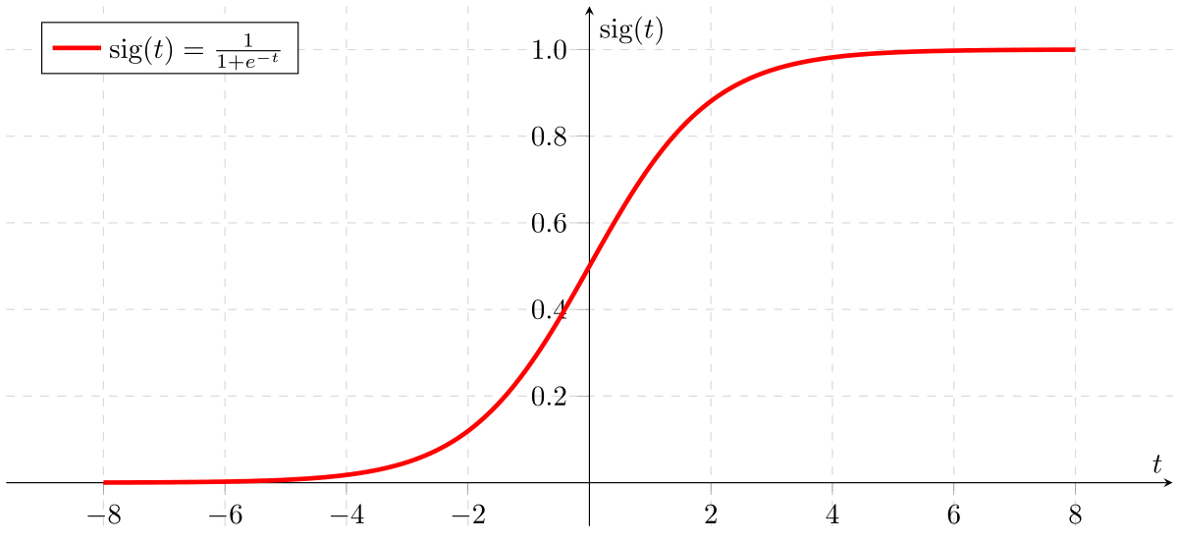
Data analysis with deep learning
benchmark for all the other more complex CNN models
one single linear layer
37.4%
Logistic Regression | AlexNet | LeNet | VGGNet
Notes:
We created a baseline Logistic Regression model to use as a benchmark for all the other more complex CNN models that we would be creating. The architecture of the model consisted of a single linear layer that took in an image, and it outputted the probability that the image belonged to either the CGI or photographic class.

Slide 24
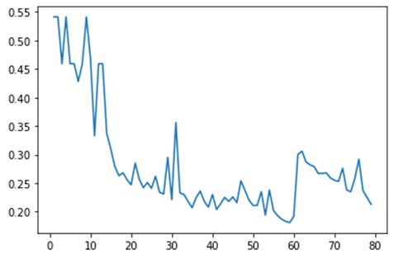
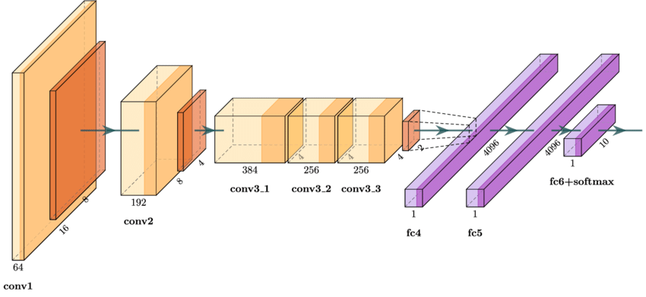
Data analysis with deep learning
AlexNet
five convolutional layers + three fully-connected layers.
Overfitting problem
23.1%
Logistic Regression | AlexNet | LeNet | VGGNet
Notes:
The architecture consists of eight layers: five convolutional layers and three fully-connected layers.
Since AlexNet has 60 million parameters, a major issue in terms of overfitting.
AlexNet is considered as the milestone of CNN for image classification. The convolution layers are used to extract the edges of the images and fully connected layers are used to learn these features. However, AlexNet is not deep enough compared to the later models. The use of large convolution filters (5*5) is also not encouraged.
Since AlexNet had 60 million parameters, a major issue is overfitting.Two methods were introduced to reduce overfitting: Data Augmentation and Dropout. Dropout works by randomly setting the outgoing edges of hidden units (neurons that make up hidden layers) to 0 at each update of the training phase.

Slide 25
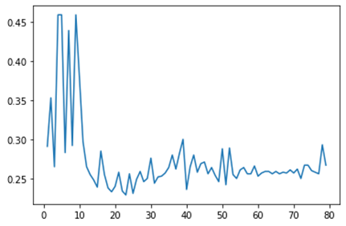
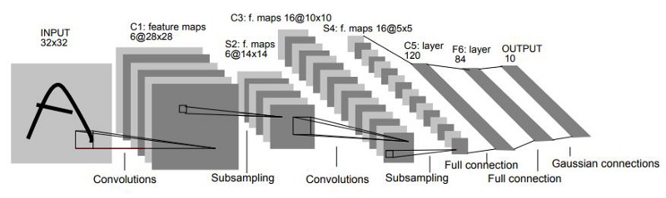
Data analysis with deep learning
two sets of convolutional and average pooling layers
flattening convolutional layer
two fully-connected layers
softmax classifier
26.7%
Logistic Regression | AlexNet | LeNet | VGGNet
Notes:
The LeNet-5 architecture consists of two sets of convolutional and average pooling layers, followed by a flattening convolutional layer, then two fully-connected layers and finally a softmax classifier.
Features:
Every convolutional layer includes three parts: convolution, pooling, and nonlinear activation functions
Using convolution to extract spatial features
Subsampling average pooling layer
tanh activation function
Using MLP as the last classifier
Sparse connection between layers to reduce the complexity of computation

Slide 26
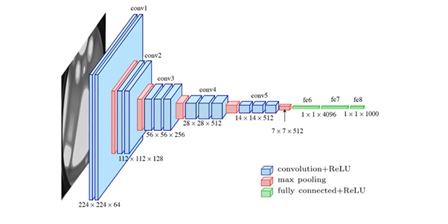
Data analysis with deep learning
Our project uses a similar structure as the VGGNet.
16 convolutional layers
Logistic Regression | AlexNet | LeNet | VGGNet

Slide 27
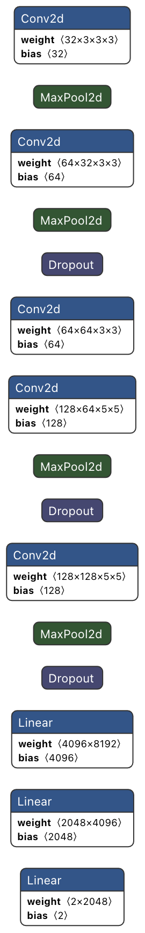
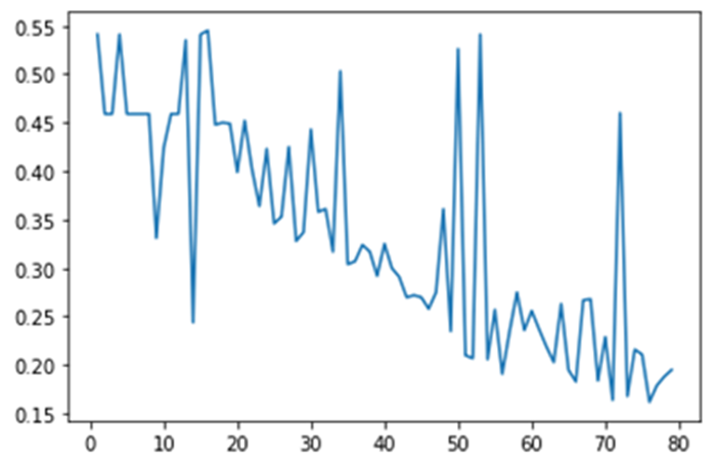
Data analysis with deep learning
Our model consists of:
5 convolutional layers
4 max pooling layers
3 dropout layers
3 linear layers.
19.5%
Logistic Regression | AlexNet | LeNet | VGGNet

Slide 28
Table of contents
Project description
Data collection
Data exploration
Pre-processing
Data analysis with deep learning
Numerical results

Slide 29
Explanation of model architecture
Similar but smaller architecture as VGGNet
Not using a full VGG model
overfitting problems
take longer time to train.
A relatively deeper network:
improve generalizability
break down the connects
model more relationships
larger receptive field.

Slide 30
Explanation of model architecture
3 x 3 filters
Why use such a small filter? instead of 7 x 7 filter
Allows for three non-linear rectification layers instead of a single one, which makes the decision function more discriminative.

Slide 31
Comparison with existing models
Logistic Regression
too simple to extract useful features
deals with continuous values
LeNet
does not do as well with color images
not able to scan for all features thus producing poor performing models
difficult for the model to generalize and create an accurate model.
AlexNet
AlexNet uses ReLU activation function
applies max pooling instead of average pooling
has overlapping pooling filters to reduce the size of the network
Dropout layers to improve generalization and reduce overfitting

Slide 32
Limitations of our work
Size of dataset
Lack of standardized dataset
Size of images
Sobel detection does not work on some input images

Slide 33
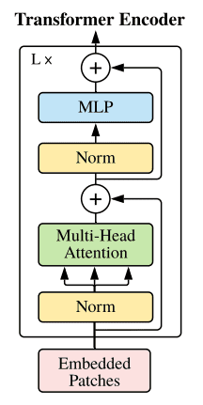
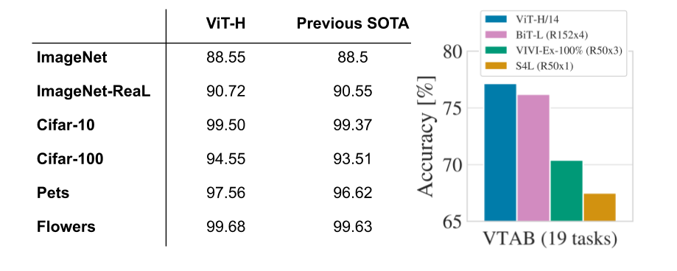
Future work
Problem with CNNs:
Designed specifically for images
Can be computationally expensive
Instead of CNNs, researchers at Google have proposed using Vision Transformers instead

Slide 34

Thank you

